Slide 1

Zoom session 6 COEN 352
Please check your mic and speaker settings.
Stop sync cloud apps such as Dropbox, Onedrive, Box, etc.
Bring a cup of tea or coffee to focus on today's tutorial.
Thanks for your collaboration.

Slide 2

Tutorial 6
COEN 352: Data structure and algorithm
TA: Mohammed A. Shehab

Slide 3

Outlines
Quick Sort.
Example 1.
Example 2.

Slide 4
Quick Sort

Slide 5
Quick Sort
A sorting algorithm that sorts a collection by choosing a pivot point.
After that, partitioning the collection around the pivot.
So the element smaller than the pivot are before it, and item larger than the pivot are after it.
Different implementations will determine a pivot element in varying ways.
There is not a right or wrong item for a pivot.

Slide 6
Quick Sort steps
Start
End
10
3
20
50
25
Partition
Pivot

Slide 7
Quick Sort steps
10
3
20
25
50
Start
End
10
3
20
25
50
Sorted
Pivot

Slide 8
Quick Sort steps
10
3
20
25
50
Start
End
10
3
20
25
50
Sorted
Partition
Pivot

Slide 9
Quick Sort steps
10
3
20
25
50
10
3
20
25
50
Start
End
Sorted
10
3
20
Sorted
Sorted
Pivot

Slide 10
Quick Sort steps
10
3
20
25
50
10
3
20
25
50
3
10
20
Combining

Slide 11
Quick Sort steps
10
3
20
25
50
10
3
20
25
50
Combining
Combining
3
10
20

Slide 12
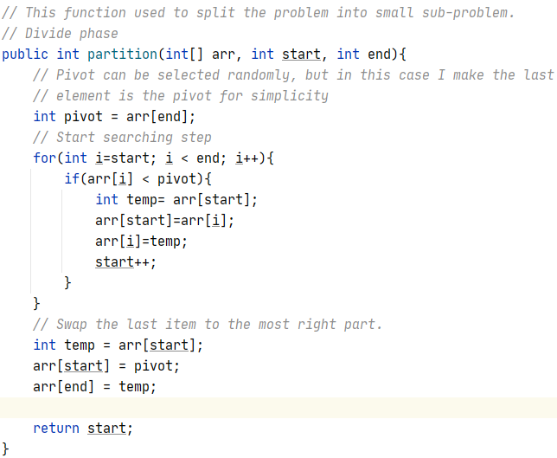
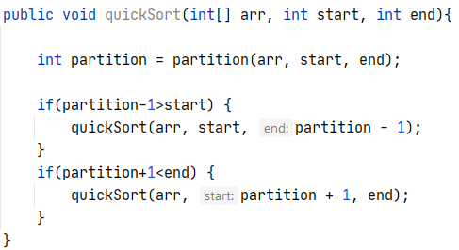
Quick Sort Java code

Slide 13
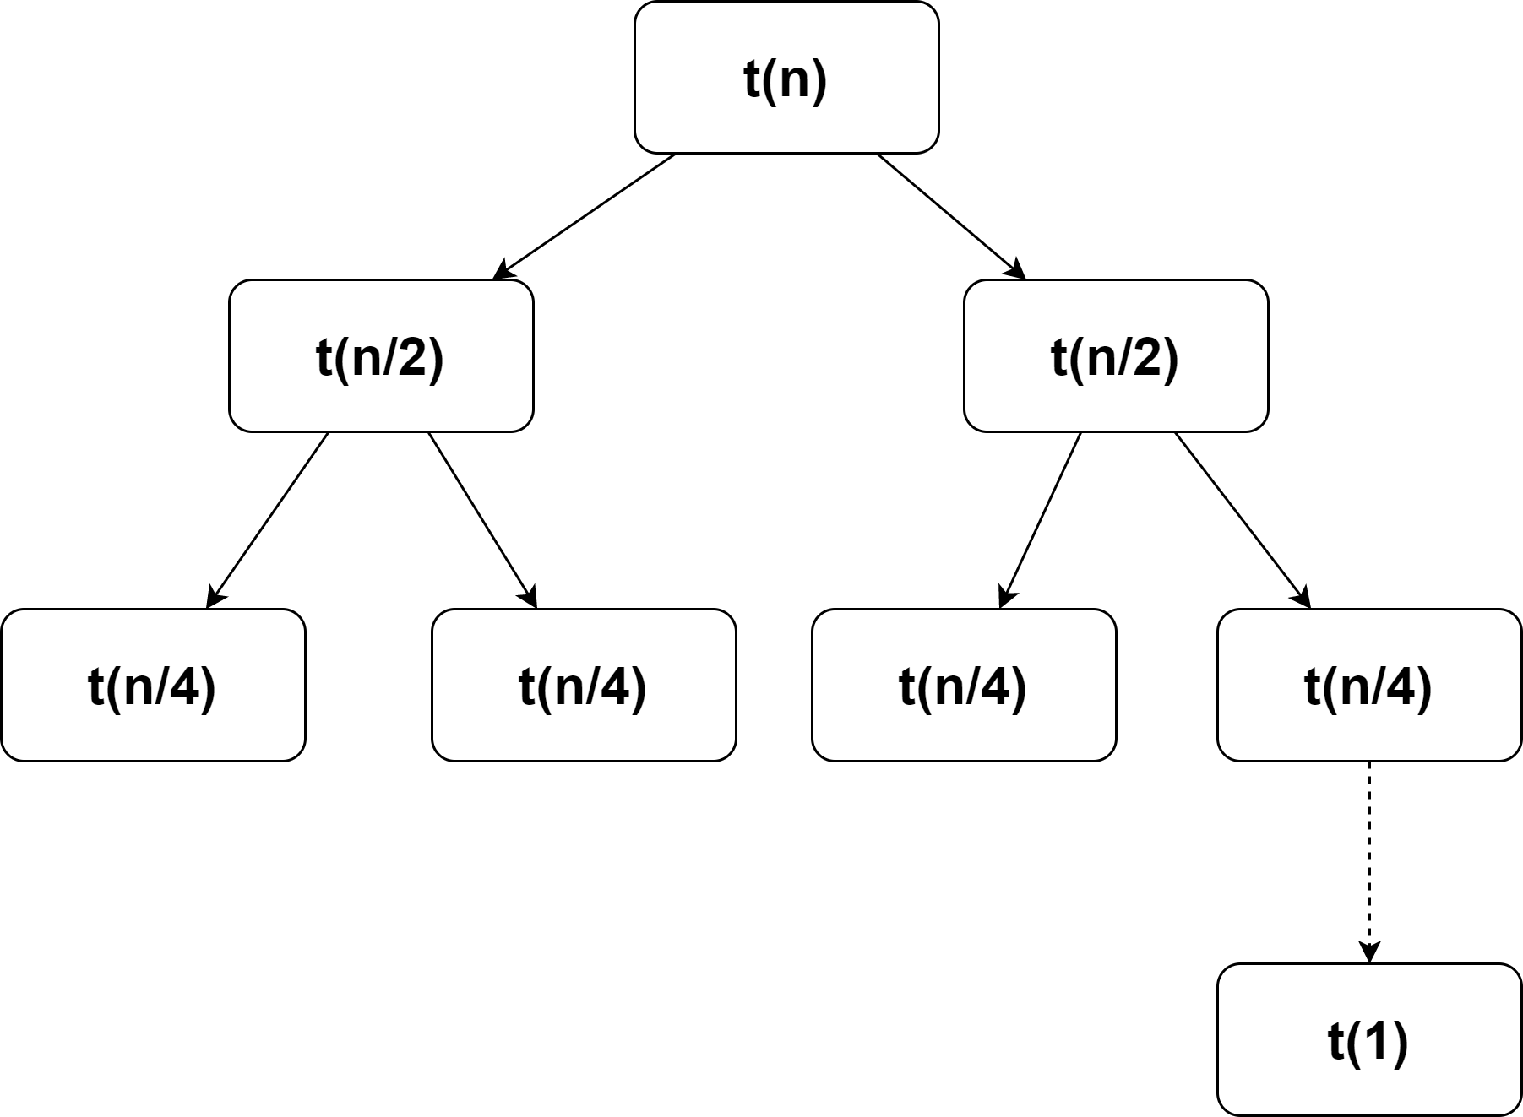
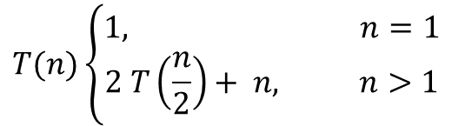
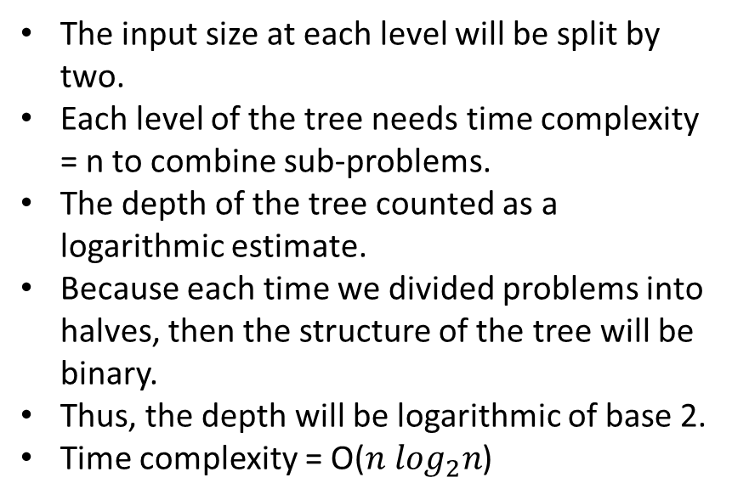
Quick Sort: proof by tracing tree
$$T(n)\left\{\begin{aligned}1, n=1 \\ 2 T\left(\frac{n}{2}\right)+ n, n>1\end{aligned}\right.$$
n
The input size at each level will be split by two.
Each level of the tree needs time complexity = n to combine sub-problems.
The depth of the tree counted as a logarithmic estimate.
Because each time we divided problems into halves, then the structure of the tree will be binary.
Thus, the depth will be logarithmic of base 2.
Time complexity = O(${n log}_{2}n$)
n
The depth of tree

Slide 14
Example 1
Apply quick sort for the following input array and display it in partition # 5?
4 | 58 | 8 | 15 | 24 | 22 | 11 | 69 | 45 | 14 | 6 | 35 | 55 | 51 | 14 | 4

Slide 15
Example 1
Apply quick sort for the following input array and display it in partition # 5?
4 | 58 | 8 | 15 | 24 | 22 | 11 | 69 | 45 | 14 | 6 | 35 | 55 | 51 | 14 | 4
4 | 4 | 8 | 15 | 24 | 22 | 11 | 69 | 45 | 14 | 6 | 35 | 55 | 51 | 14 | 58
Partition(arr, 0,15)

Slide 16
Example 1
Apply quick sort for the following input array and display it in partition # 5?
4 | 58 | 8 | 15 | 24 | 22 | 11 | 69 | 45 | 14 | 6 | 35 | 55 | 51 | 14 | 4
4 | 4 | 8 | 15 | 24 | 22 | 11 | 69 | 45 | 14 | 6 | 35 | 55 | 51 | 14 | 58
4 | 4 | 8
Partition(arr, 0,15)
Partition(arr, 0,2)

Slide 17
Example 1
Apply quick sort for the following input array and display it in partition # 5?
4 | 58 | 8 | 15 | 24 | 22 | 11 | 69 | 45 | 14 | 6 | 35 | 55 | 51 | 14 | 4
4 | 4 | 8 | 15 | 24 | 22 | 11 | 69 | 45 | 14 | 6 | 35 | 55 | 51 | 14 | 58
4 | 4 | 8
 |  |  | 15 | 24 | 22 | 11 | 45 | 14 | 6 | 35 | 55 | 51 | 14 | 58 | 69
Partition(arr, 0,15)
Partition(arr, 0,2)
Partition(arr, 2,15)

Slide 18
Example 1
Apply quick sort for the following input array and display it in partition # 5?
4 | 58 | 8 | 15 | 24 | 22 | 11 | 69 | 45 | 14 | 6 | 35 | 55 | 51 | 14 | 4
4 | 4 | 8 | 15 | 24 | 22 | 11 | 69 | 45 | 14 | 6 | 35 | 55 | 51 | 14 | 58
4 | 4 | 8
 |  |  | 15 | 24 | 22 | 11 | 45 | 14 | 6 | 35 | 55 | 51 | 14 | 58 | 69
 |  |  | 11 | 6 | 14 | 15 | 45 | 14 | 24 | 35 | 55 | 51 | 22
Partition(arr, 0,15)
Partition(arr, 0,2)
Partition(arr, 2,15)
Partition(arr, 3,13)

Slide 19
Example 1
Apply quick sort for the following input array and display it in partition # 5?
4 | 58 | 8 | 15 | 24 | 22 | 11 | 69 | 45 | 14 | 6 | 35 | 55 | 51 | 14 | 4
4 | 4 | 8 | 15 | 24 | 22 | 11 | 69 | 45 | 14 | 6 | 35 | 55 | 51 | 14 | 58
4 | 4 | 8
 |  |  | 15 | 24 | 22 | 11 | 45 | 14 | 6 | 35 | 55 | 51 | 14 | 58 | 69
 |  |  | 11 | 6 | 14 | 15 | 45 | 14 | 24 | 35 | 55 | 51 | 22
 |  | 6 | 11 | 8
4 | 4 | 6 | 11 | 8 | 14 | 15 | 45 | 14 | 24 | 35 | 55 | 51 | 22 | 58 | 69
Partition(arr, 0,15)
Partition(arr, 0,2)
Partition(arr, 2,15)
Partition(arr, 3,13)
Partition(arr, 3,5)

Slide 20

Hybrid solution
Combination of more than one algorithm for efficiently solving the problem.
The main problem in this session is to optimize the quick sort algorithm.
In the average case, the quicksort runs with O($\operatorname{nlog}{n}$), but in the worst case, it can reach the O($n^{2}$) as time complexity.
When the number of elements is below some threshold (perhaps 10 elements).
Switch to a non-recursive sorting algorithm such as insertion sort.
It performs fewer swaps, comparisons, or other operations on such small arrays.
https://www.techiedelight.com/hybrid-quicksort/

Slide 21
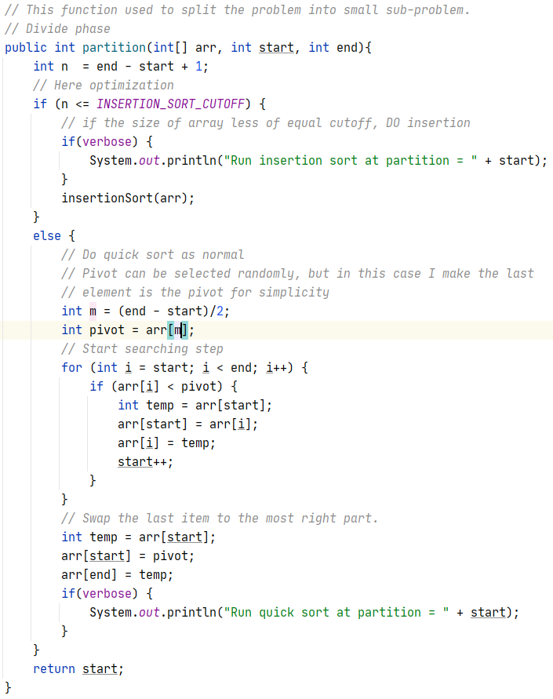
Example 2
Write a Java implementation to find the right cutoff to switch to insertion sort.

